Slide 1
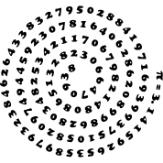
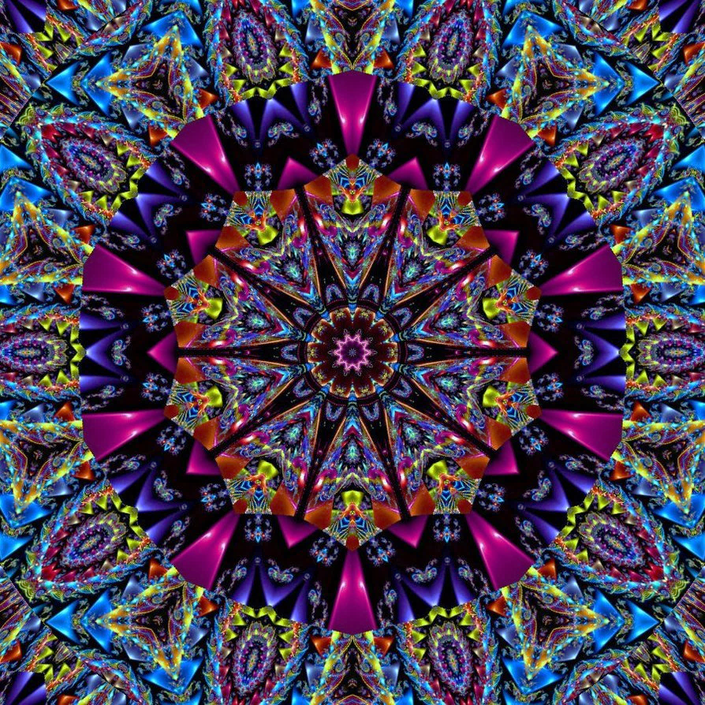


Mathematical Kaleidoscope
Polish team

Slide 2
Quotes
Without mathematics, there's nothing you can do. Everything around you is mathematics. Everything around you is numbers
Shakuntala Devi
Mathematics knows no races or geographic boundaries; for mathematics, the cultural world is one country.
David Hilbert
Mathematics is the most beautiful and most powerful creation of the human spirit.
Stefan Banach

Slide 3
Quotes
Do not worry about your difficulties in Mathematics. I can assure you mine are still greater.
Albert Einstein
The only way to learn mathematics is to do mathematics.
Paul Halmos
Mathematics is not about numbers, equations, computations, or algorithms: it is about understanding.
William Thurston

Slide 4
Anecdotes about mathematicians
Boole (english 1815-1864)
Boole was a teacher at Queen's College in Cork and one day, as he was walking the 3 kms trip from his home, it started to rain and he cought pneumonia. His wife, thinking a treatment should resemble the cause of the sickness, put him into bed and threw bowls of water on him for several days! That had as an effect to prematuraly put an end to a brilliant carreer...
Pascal (french 1623-1662)
On November 23rd 1654 between 10:30 am and 12:30 pm, Pascal goes into religious raptures and gives up sciences for theology, what remains famous. One 1658 evening, though, a violent headache prevents him from sleeping. He then decides to think about the cycloid to forget the pain. He really was surprised while noticing that the headache stopped straight away ! He concluded afterwards that it must have been a sign of God, who surely liked mathematicians !

Slide 5
Maths jokes
A mathematician is asked to design a table. He first designs a table with no legs. Then he designs a table with infinitely many legs. He spend the rest of his life generalizing the results for the table with N legs (where N is not necessarily a natural number).
Q: Why do plants hate math?
A: Because it gives them square roots.
What is the difference between a Psychotic, a Neurotic and a Mathematician? A Psychotic believes that 2+2=5. A Neurotic knows that 2+2=4, but it kills him. A Mathematician simply changes the base.

Slide 6
Riddles and puzzle
2 fathers and 2 sons ate 3 eggs for breakfast, each eating exactly one egg. How could that be?
An apple costs half a dollar while a pear costs a dollar. Bob at first bought an apple, then he tought: "I already paid half a dollar, and I have an apple that is also worth half a dollar. So if I give teh apple to the shopkeeper, , he would overall receive a dollar from me. That should be enough to get me a pear." Is Bob right?
In a certain country ½ of 5 = 3. If the same proportion holds, what is the value of 1/3 of 10 ?

Slide 7
Riddles and puzzle
Three Guys at A Hotel Riddle
  Three guys rent a hotel room for the night. When they get to the hotel they pay the $$\$30 $$ fee, then go up to their room. Soon the bellhop brings up their bags and gives the lawyers back $5 because the hotel was having a special discount that weekend. So the three lawyers decide to each keep one of the $5 dollars and to give the bellhop a $2 tip. However, when they sat down to tally up their expenses for the weekend the could not explain the following details:
  Each one of them had originally paid $10 (towards the initial $30), then each got back $1 which meant that they each paid $9. Then they gave the bellhop a $2 tip. HOWEVER, 3 • $9 + $2 = $29
  The guys couldn't figure out what happened to the other dollar. After all, the three paid out $30 but could only account for $29.
  Can you determine what happened?

Slide 8
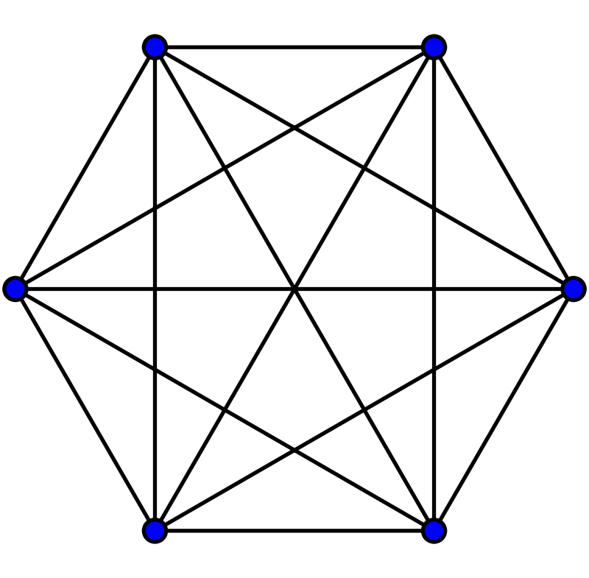
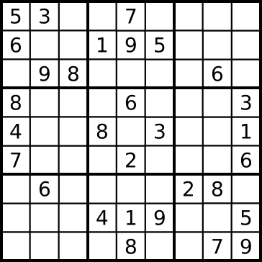
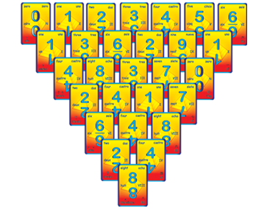
Mathematical games
Sudoku
Calculatrivia
Pyramath
Sim (pencil game)

Slide 9
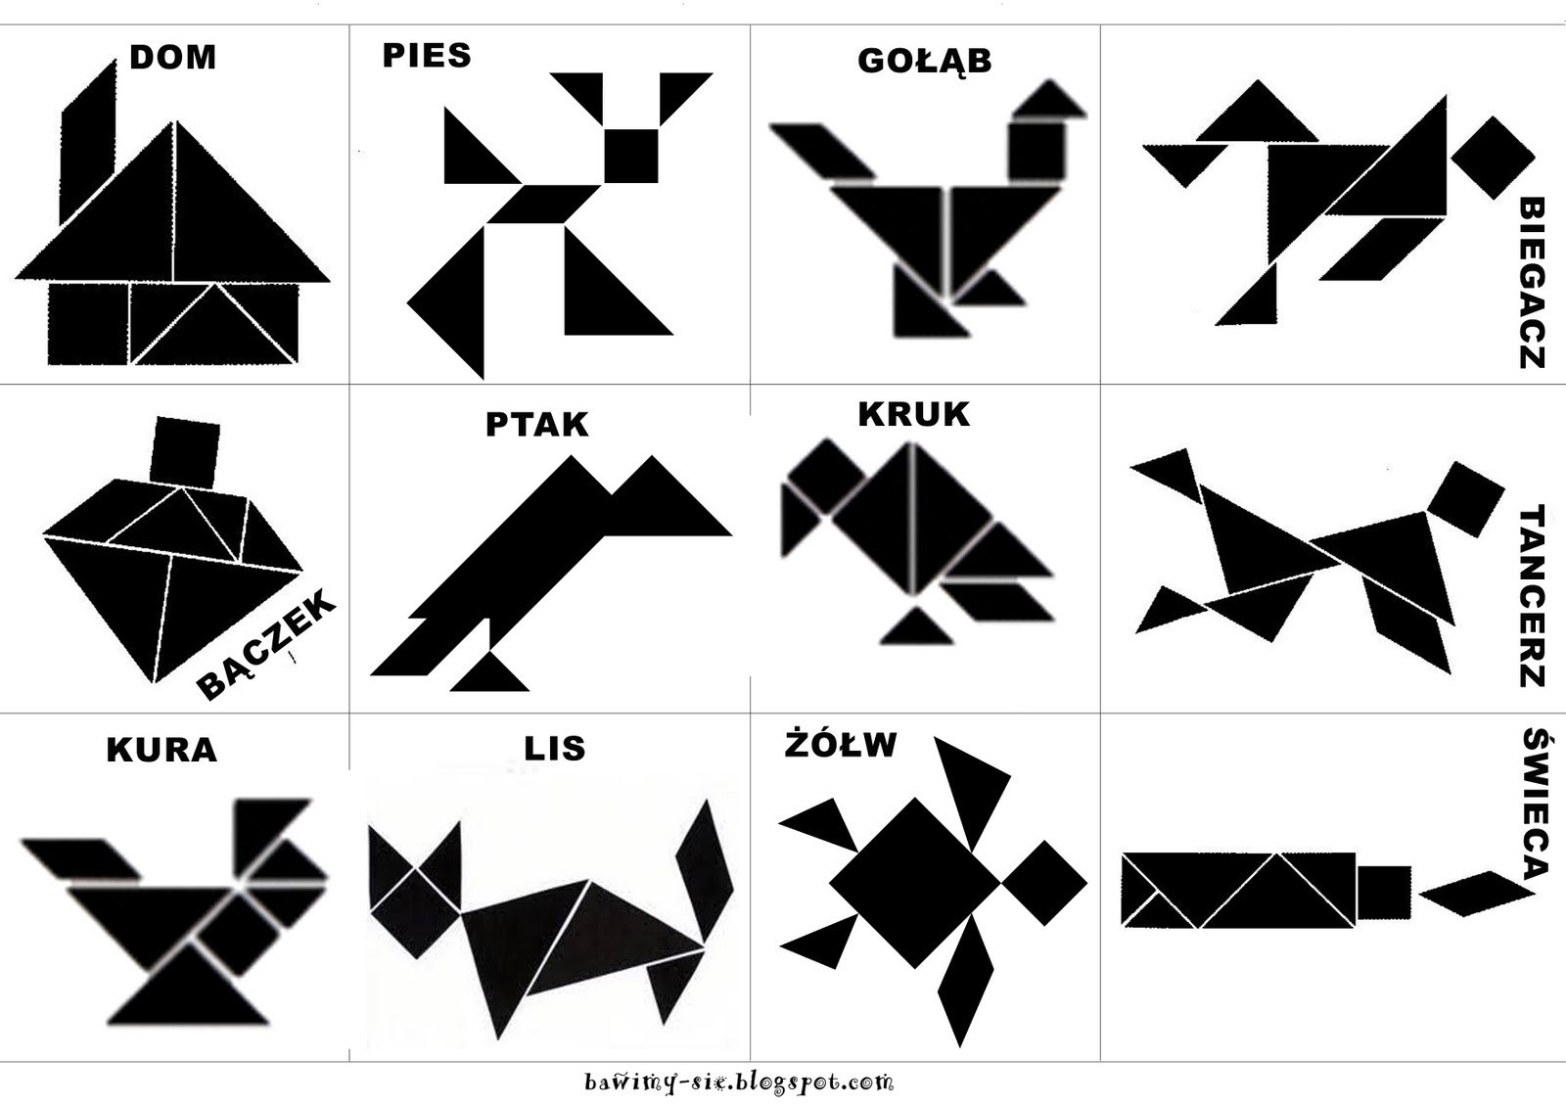
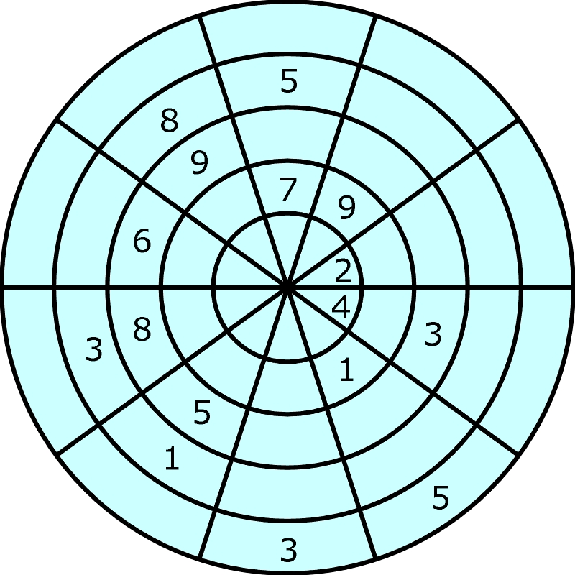
Mathematical games

Slide 10
Curiosities
Among all shapes with the same area circle has the shortest perimeter.
The Prime Number Spiral was allegedly discovered by physicist Stanislaw Ulam while doodling during a boring physics talk. When the natural numbers are arranged in a spiral on a grid, and the prime numbers are highlighted, an interesting pattern emerges: diagonal lines appear. The effect seems sufficiently obvious to preclude any sort of optical illusion, but thus far there is no explanation for the effect.
Ancient Babylonians did math in base 60 instead of base 10. That's why we have 60 seconds in a minute and 360 degrees in a circle.

Slide 11
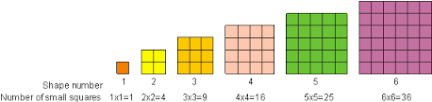
Curiosities
Figurate numbers look like the shape that they are named after. There are tons of these, but we’ll examine just three.
Perfect Squares
These numbers can be arranged to look like squares: 4,9,16

Slide 12
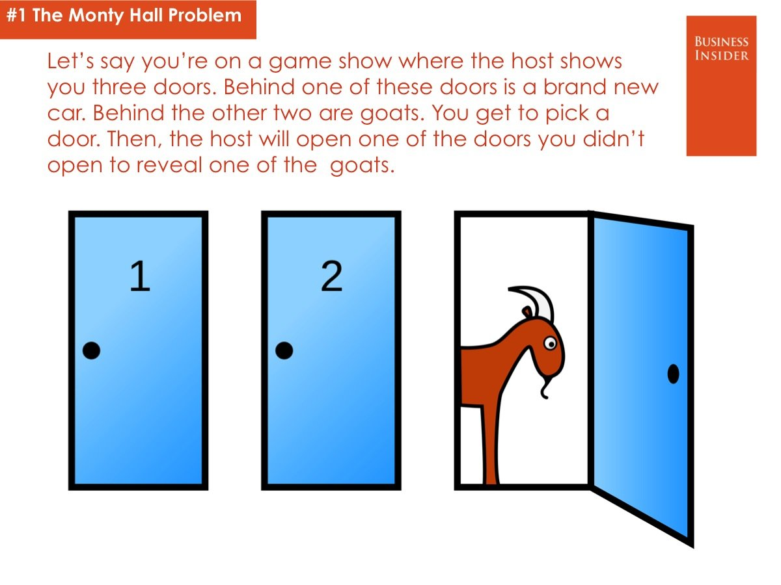
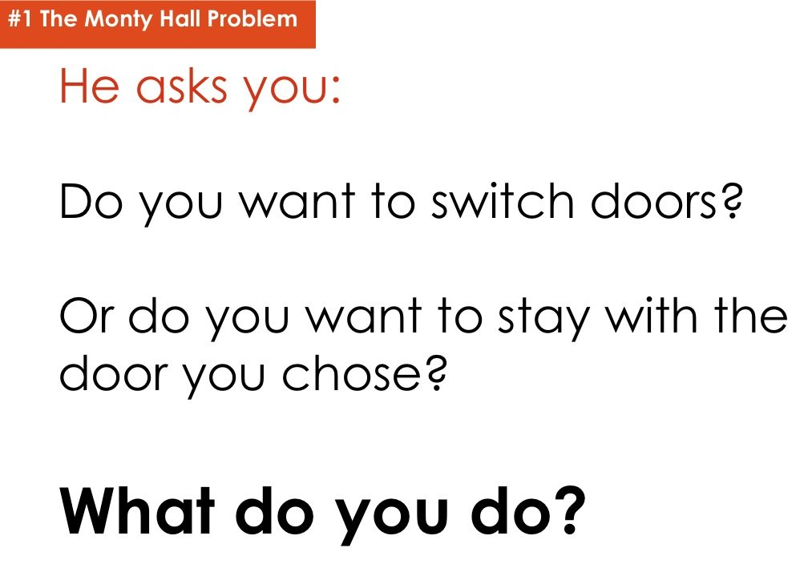
Maths tasks

Slide 13
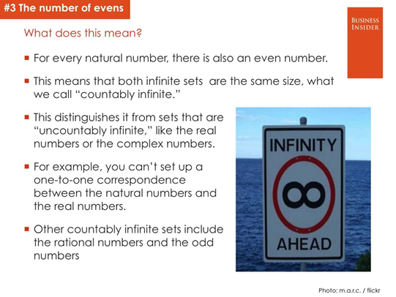
Maths tasks

Slide 14
Maths in life
Cooking by Numbers
Ingredients have relationships to each other in a recipe is an important concept in cooking. It's also an important math concept. In math, this relationship between 2 quantities is called a ratio. If a recipe calls for 1 egg and 2 cups of flour, the relationship of eggs to cups of flour is 1 to 2. In mathematical language, that relationship can be written in two ways:
1/2 or 1:2
Home Decorating
Imagine you're planning to buy new carpeting for your home. You're going to put down carpeting in the living room, bedroom, and hallway, but not in the bathroom. You could try to guess at how much carpet you might need to cover these rooms, but you're better off figuring out exactly what you need. To determine how much carpet you'll need, you'll use this simple formula:
A = L x W

Slide 15
Maths in life
At School and Work
Jobs in business and finance may require sophisticated knowledge of how to read profit and earning statements. However, even hourly earners will need to know if their working hours times their rate of pay accurately reflects their paychecks.
At home
- People on medication need to understand different dosages, whether in grams or milliliters.
- Recipes call for accurate proportions.
- Setting an alarm and hitting snooze, people may quickly need to calculate the new time they will arise.

Slide 16
Bibliography
https://www.google.pl/search?q=quotes+mathematicians
http://www.brainyquote.com/quotes/keywords/mathematics.html
http://www.mathgoodies.com/articles/stories.html
http://math.stackexchange.com/questions/28885/anecdotes-about-famous-mathematicians-or-physicists
http://www.pi314.net/eng/anecdotes.php
http://www.rd.com/jokes/math/
http://www.mathwarehouse.com/riddles/math-riddles.php
http://goodriddlesnow.com/math-riddles
https://www.google.pl/search?q=sudoku
https://curiosity.com/subjects/math/
http://www.insidemathematics.org/performance-assessment-tasks
http://www.businessinsider.com/the-most-controversial-math-problems-2013-3/?IR=T
http://www.educationworld.com/a_curr/curr148.shtml

