Slide 1
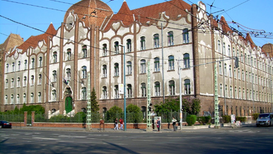
XIV. Kerületi Teleki Blanka Gimnázium
Budapest, Hungary

Slide 2
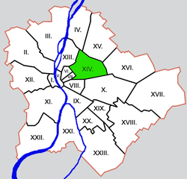
Location
Our school is located in Budapest, in the 14th District. This district is called Zugló.

Slide 3
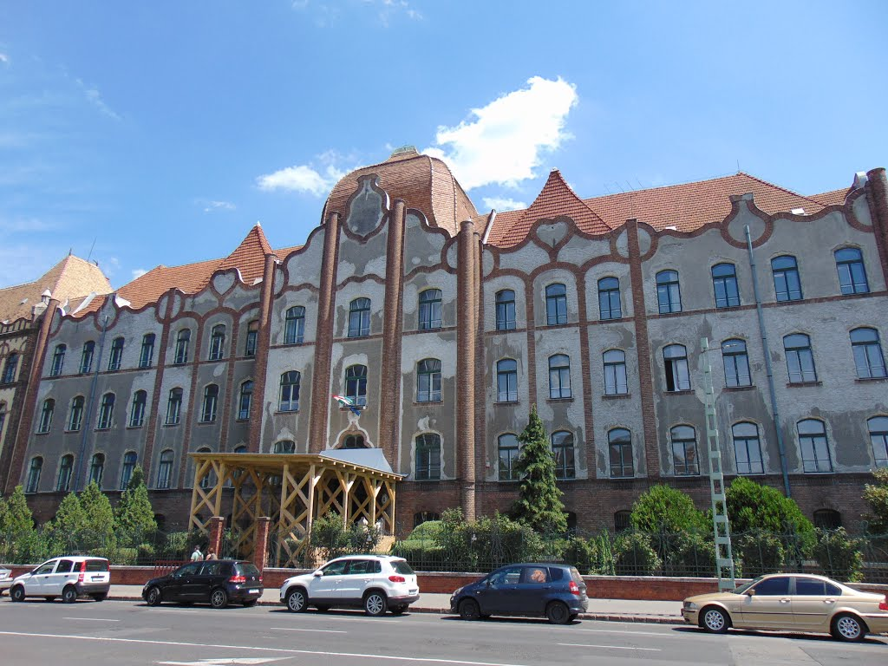
Some information
The school was established in 1873 it is one of the oldest in Budapest. The present building was built in 1901-1902. 566 students attend the school and almost 50 teachers are here. It’s a secondary school.

Slide 4
The school NOW
Every year four different classes are launched. Here you can recieve advanced training in different subjects:
Biology
Maths
History
Physics
Literature
Media
Languages (English, German)

Slide 5
History
In 1896, the scope of the institution had grown so large that a new school had to be built.
In 1902 the current school building was completed in Art Nouveau style.

Slide 6
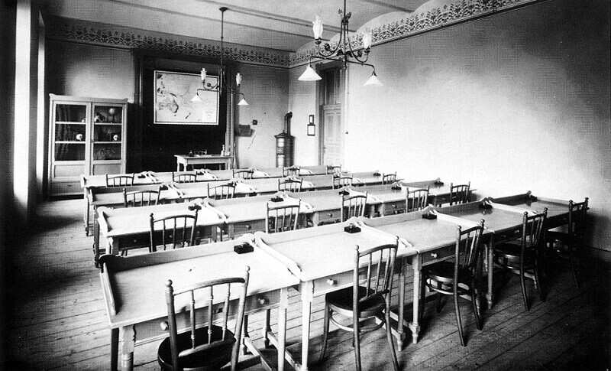
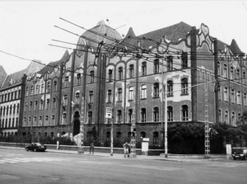
History
Spacious classrooms, comfortable dorm rooms, library, gymnasium, laboratories, tennis and skating rinks, rock garden provided the students with the most modern education.

Slide 7
History
In 1950, the school changed its name to Teleki Blanka and the eight-year training became a four-year one. This school was only for ladies until 1963/64 after that male students could attend as well.

Slide 8
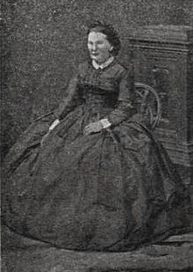
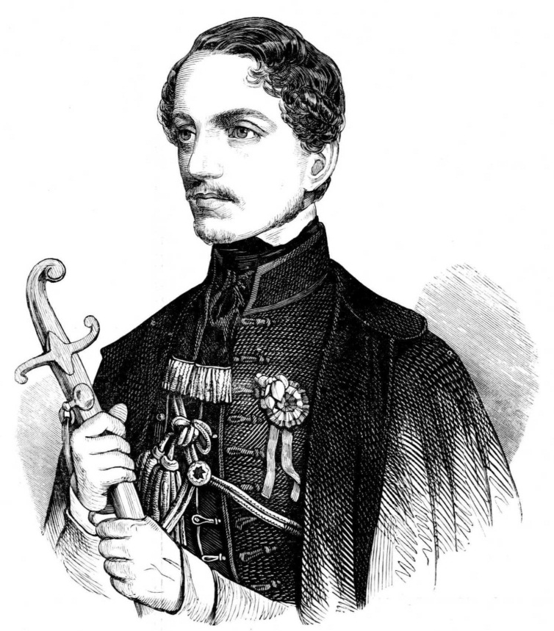
Famous teachers
Pál Vasvári – historian, revolutionary
Klára Leövey - writer

Slide 9
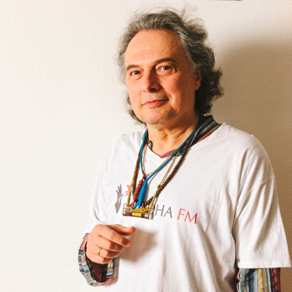
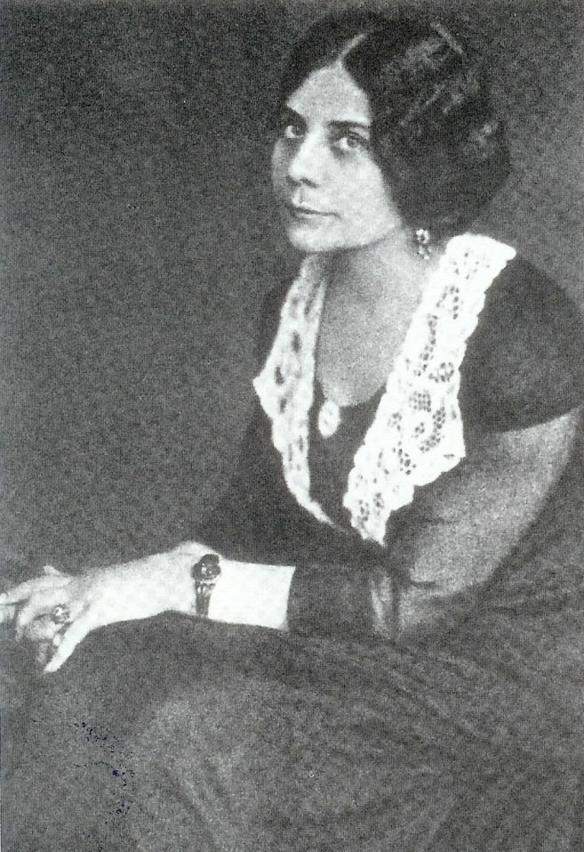
Famous students
András Laár – musician
Margit Kaffka – writer

Slide 10
Thank you for your attention

