Slide 1
Budapest

Slide 2
Budapest’s coat of arms

Slide 3
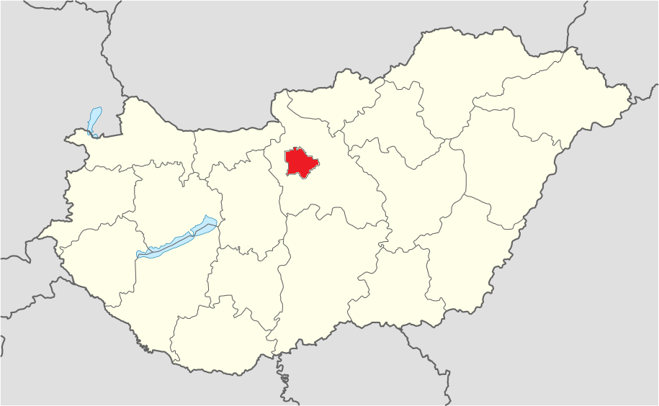
Where is it?
Budapest

Slide 4
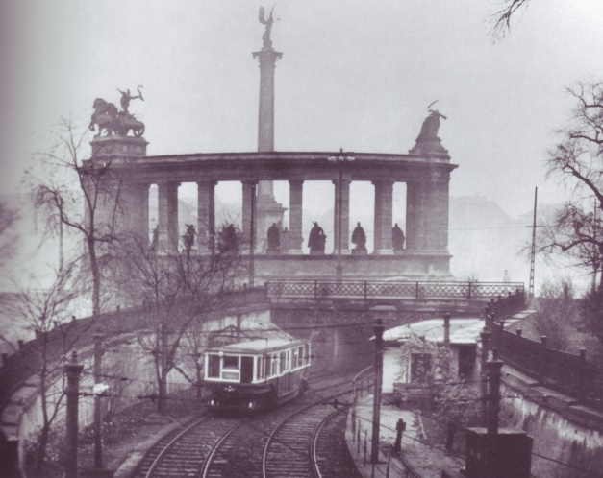
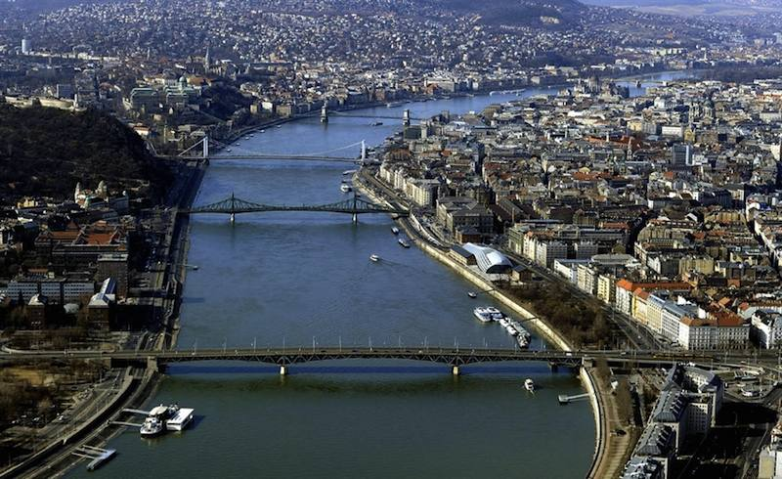
Facts about Budapest
It is the capital city of Hungary
It is the biggest city of Hungary
20% of Hungary’s population lives in Budapest
Population is over 1,7 million
It has 9 bridges
Budapest has the oldest subway-line in Europe

Slide 5
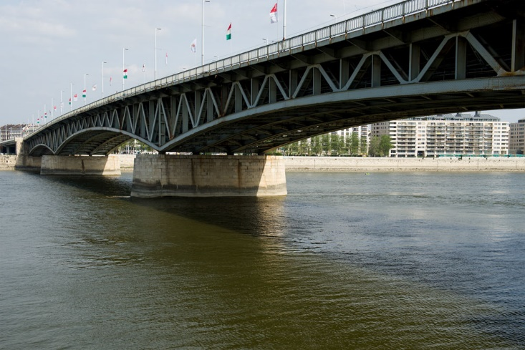
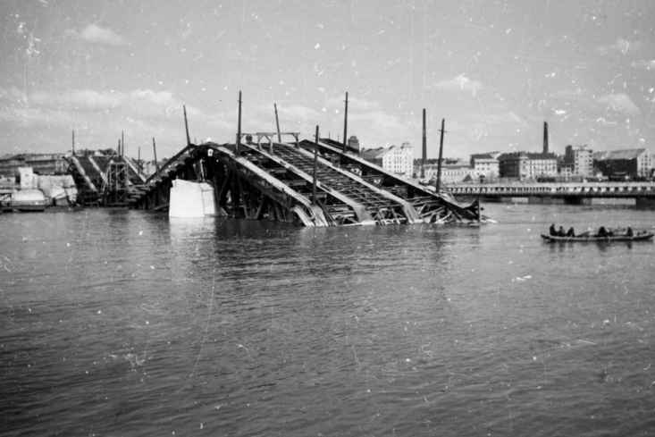
History of Budapest
in the XVI. century the Turkish occupied Hungary
and stayed here for more than 150 years
In 1873, Pest, Buda and Óbuda were united, and
with that, the Hungarian capital was established
with the name of Budapest.
It was bombed during the Second World War

Slide 6
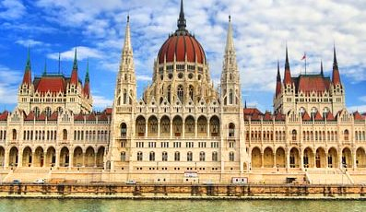
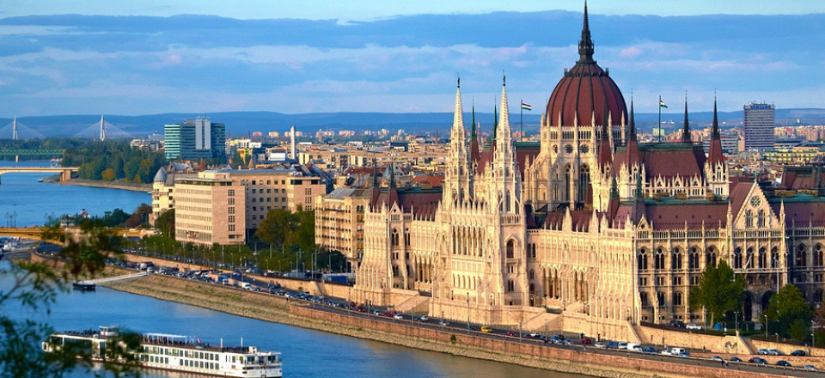
Hungarian Parliament

Slide 7
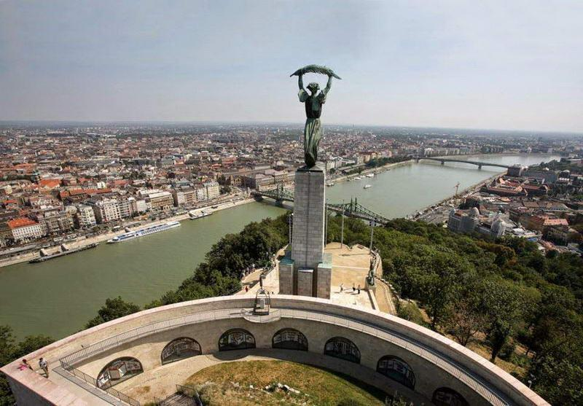
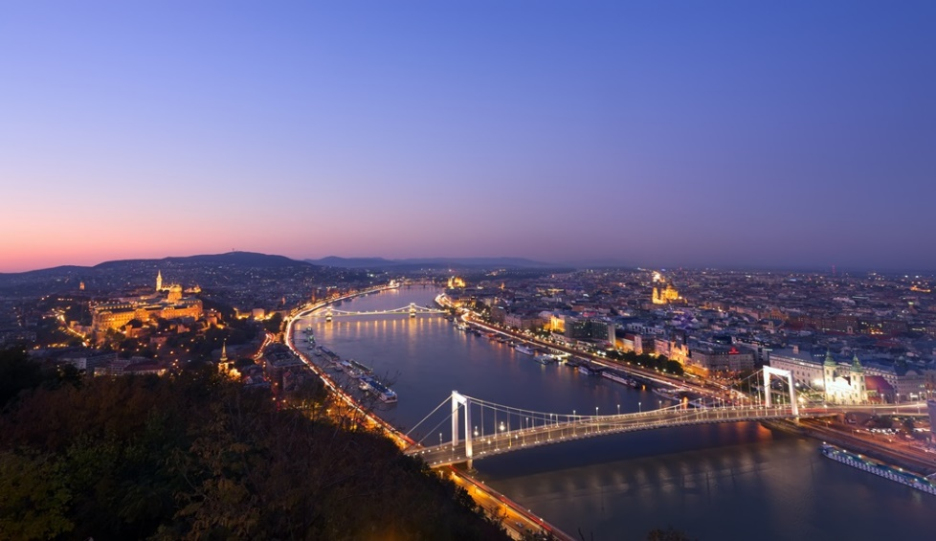
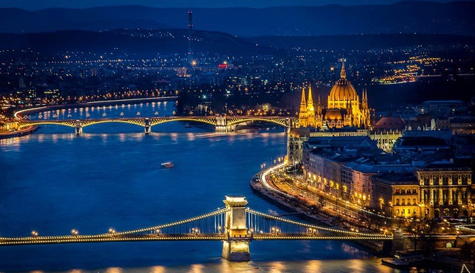
Citadel’s Panorama

Slide 8
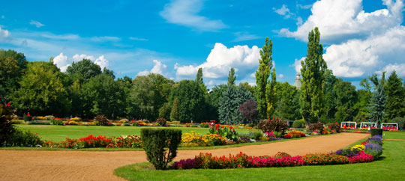
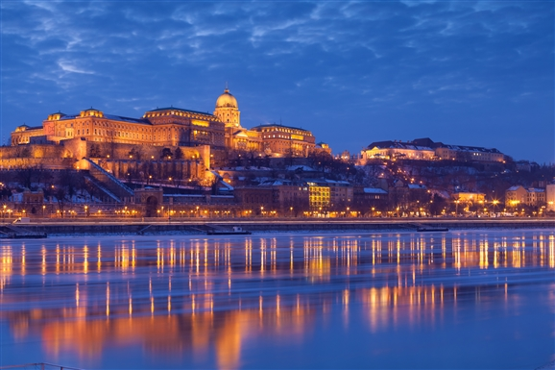
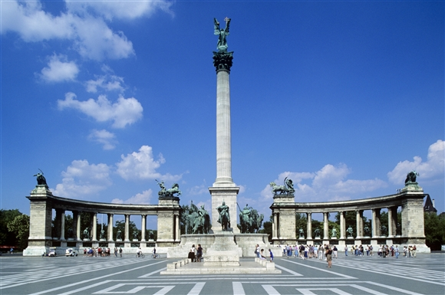
Do not miss
Margaret Island
Castle Hill
Fisherman’s Bastion
Heroes’ Square

Slide 9
Welcome to Hungary in February 2018

